Slide 1


Slide 2


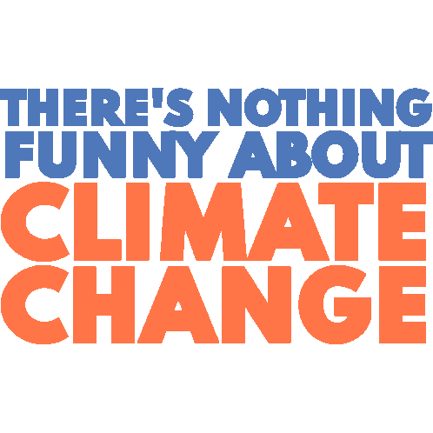
Global warming climate changes and cyclones
A Short presentation from
Varun h. gaur
(Computer engineering, 210410107077, ce2a)
(till the basis on January 1, 2022)

Slide 3
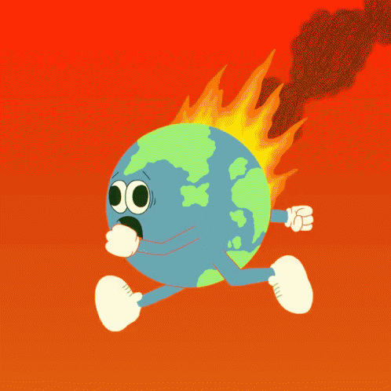
Global warming: definition and scope
Global Warming is a phenomenon where heat is induced either naturally or anthropogenically, and spread out to increase the average temperature of earth.
It is believed that this term was coined in 1975 at the Columbia University, California. Then it become a dominant popular in June 1988.
(In Centigrade Measurement) From the statistical data, the average surface temperature has been from -0.4 in 1900s to +0.35 in 1980 to +1.05 in 2021.

Slide 4
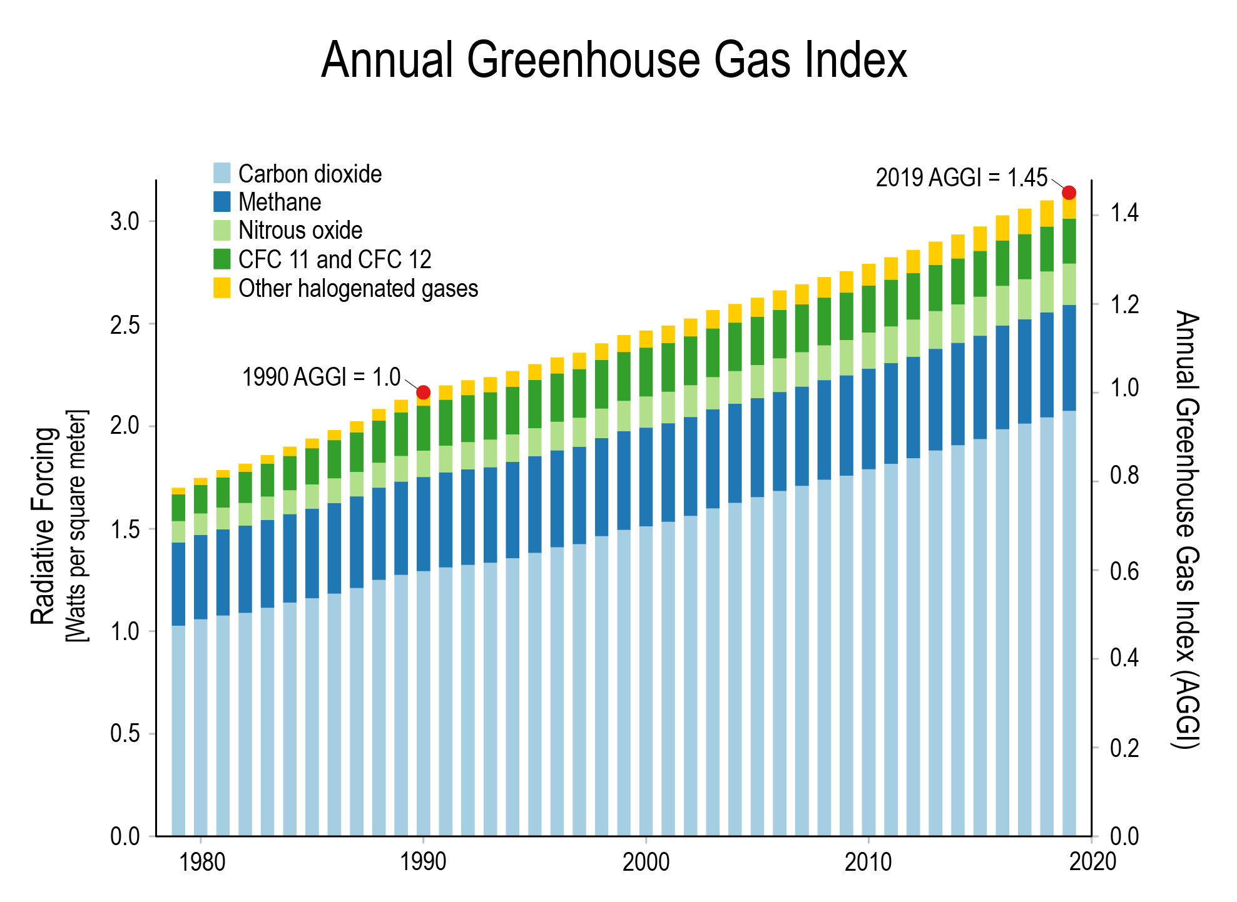
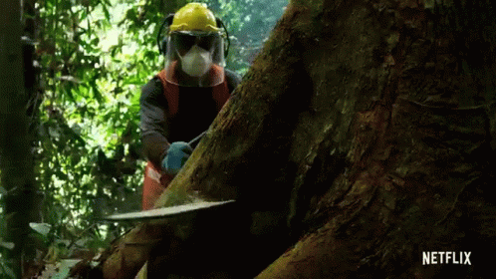
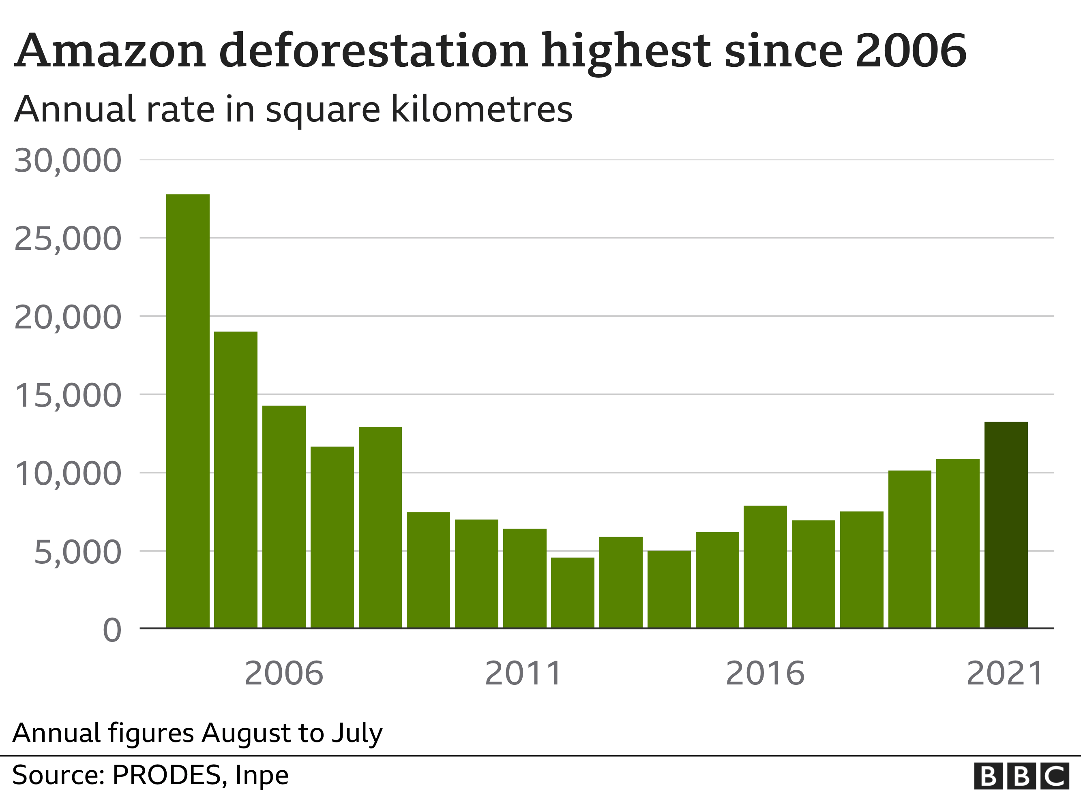
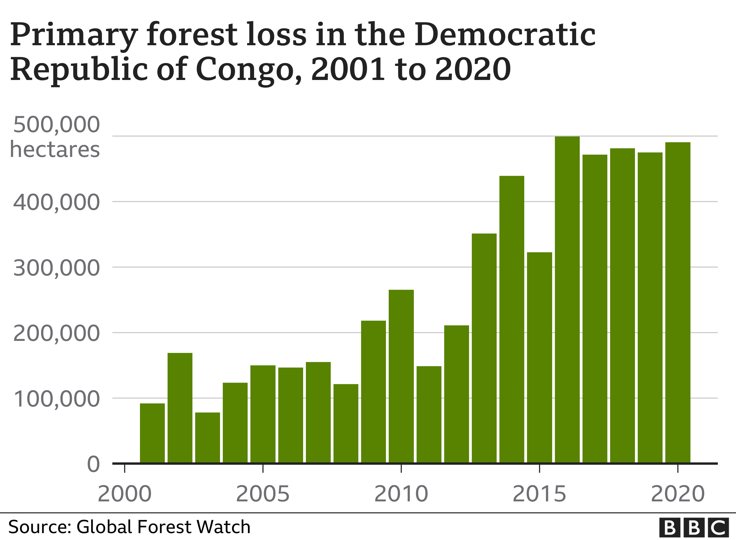
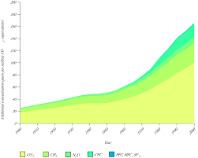
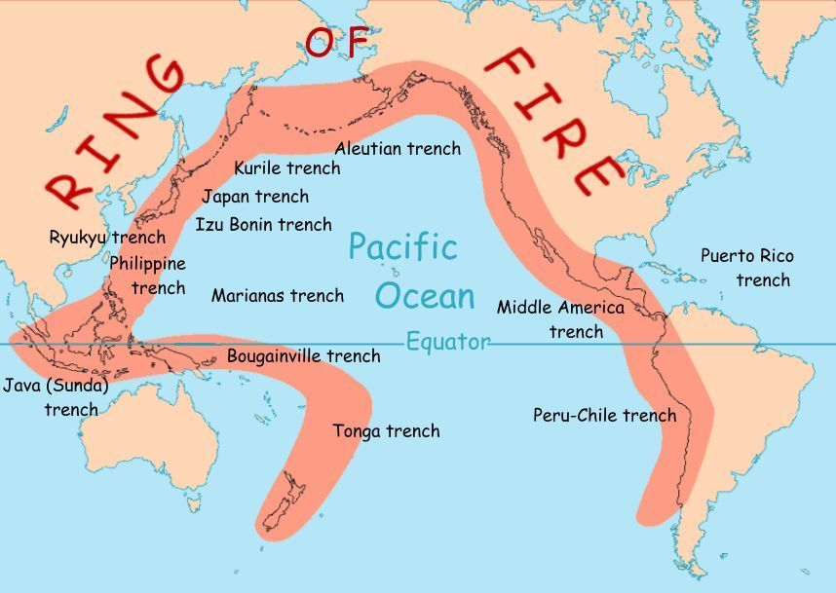
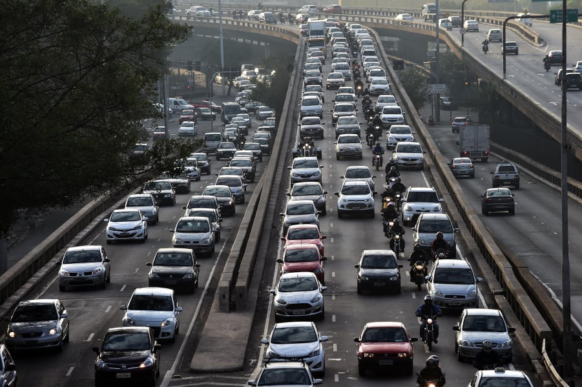
GLOBAL WARMING: CAUSES
Greenhouse Effect: Heat trap of Gases which stays under the atmosphere blanket, which acts as a catalyst to warm the earth EXCLUDING participation of Sunlight Rays. (Sources: Automobiles, especially those who haven’t under control certificate for years; Industrial Gases, and much more)
Overuse of Fossils: Decayed Materials; also produce harmful gases. Indirectly responsible for Air Pollution (Sources: Vehicles, Coal-dependent Power Plants, Ships and Airplanes)
Volcanic Eruptions: Releases large amount of CO2 gas, Completely Natural Cause: Indirectly from Earth’s Magnetic Field
Deforestation/ Cutting Trees Down: Done because of todays needs, and land for agriculture and residential areas.

Slide 5
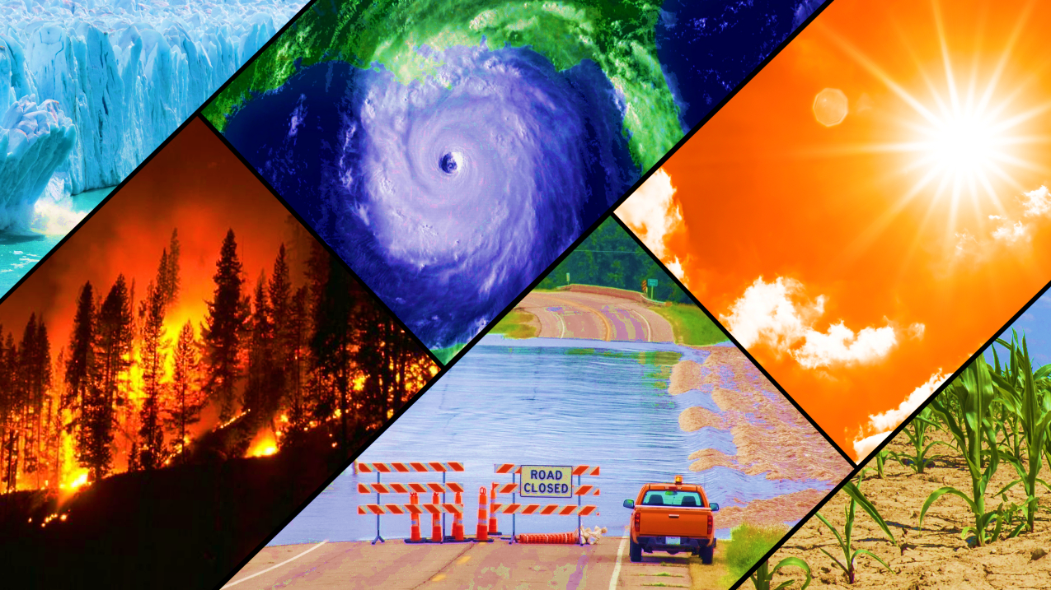
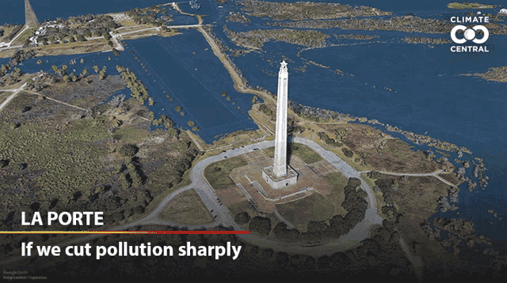
Effects of global warming
A Chain of Rising Sea Level: DECLINE in ARCTIC SEA ICE makes INCLINE at SEA LEVEL RISE.: Thermal Expansion of Ice leads to rise in sea level; Islands are at risk. Ground waters will be more saline, large land will turn useless.
Change and Increase of Global Temperatures.
Climate Changes: Uneven distribution of rainfall, extreme climate, uneven rise and cooldown of temperatures, and much more.
Breeding of Insects that affects human life: Changes in rainfall pattern also leads to distribution of water borne diseases like malaria, filariasis, elephantiasis, etc. Also reduces crop production by increase of plants and pests.
Forest fires: Burning of trees above at a specific temperature.

Slide 6
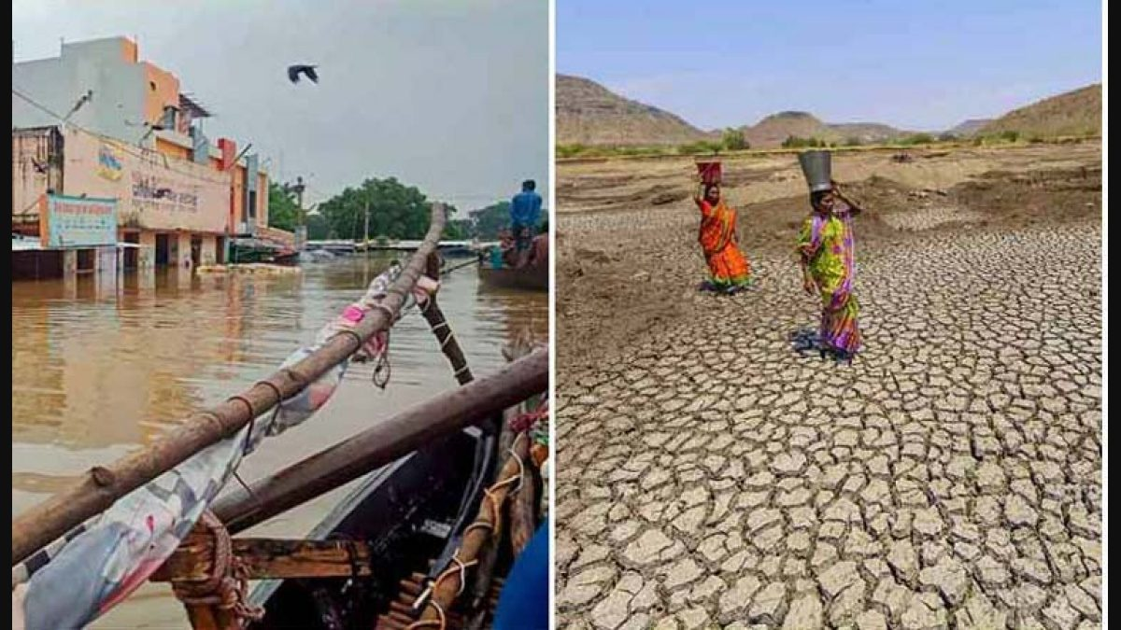
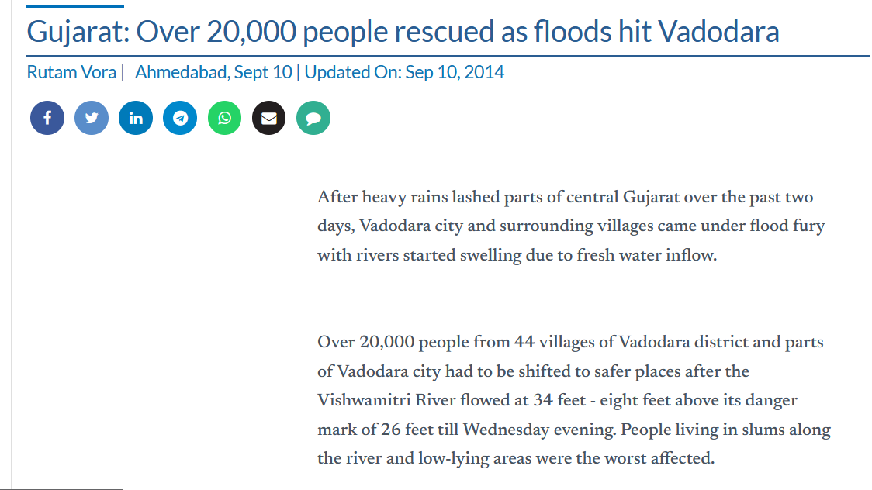
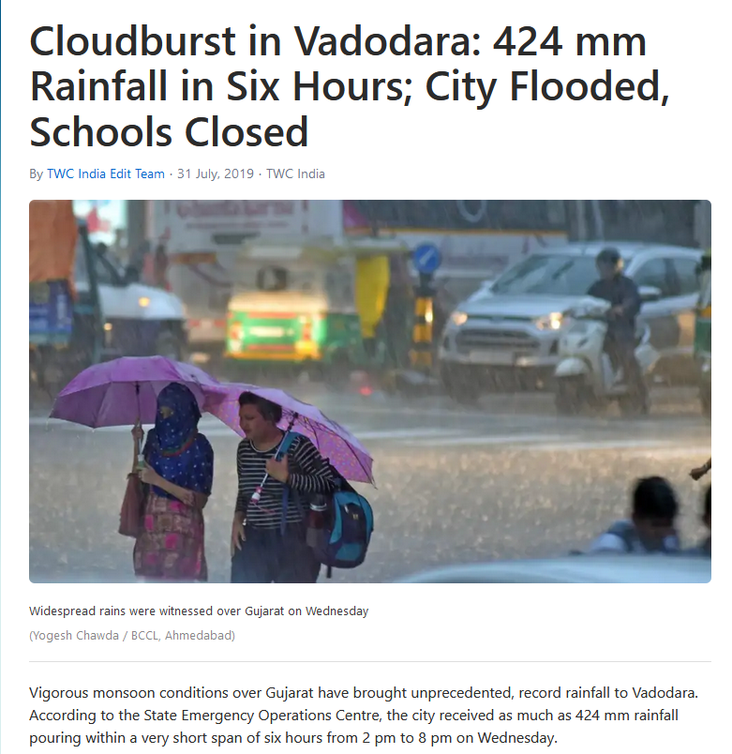
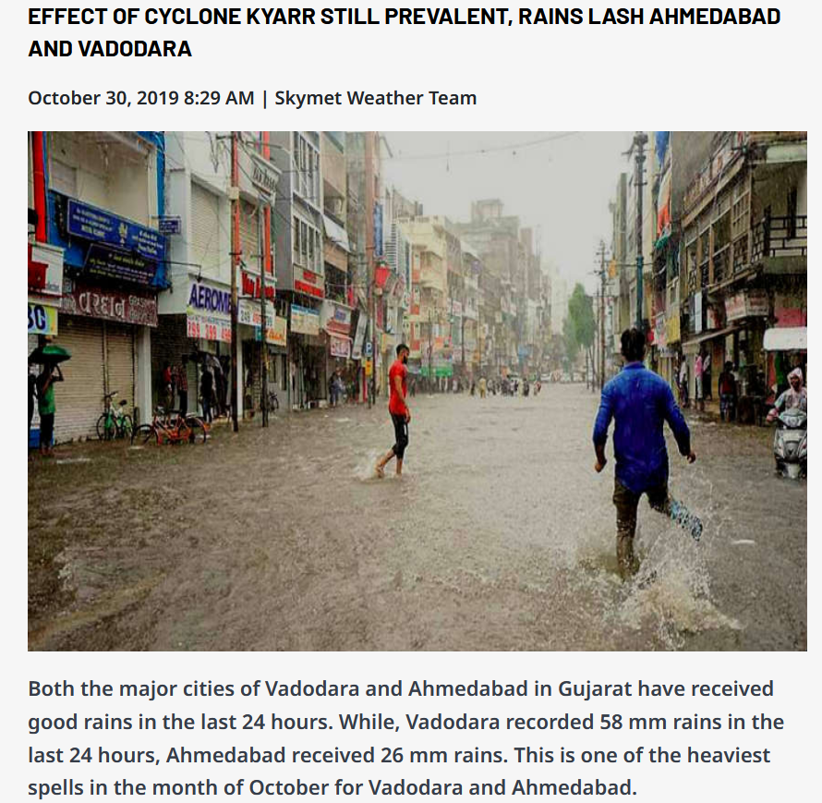
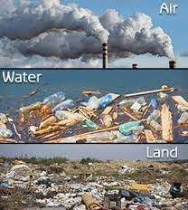
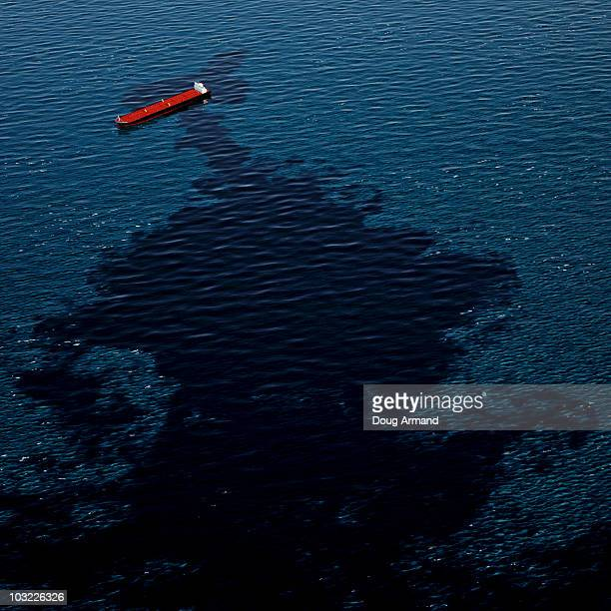
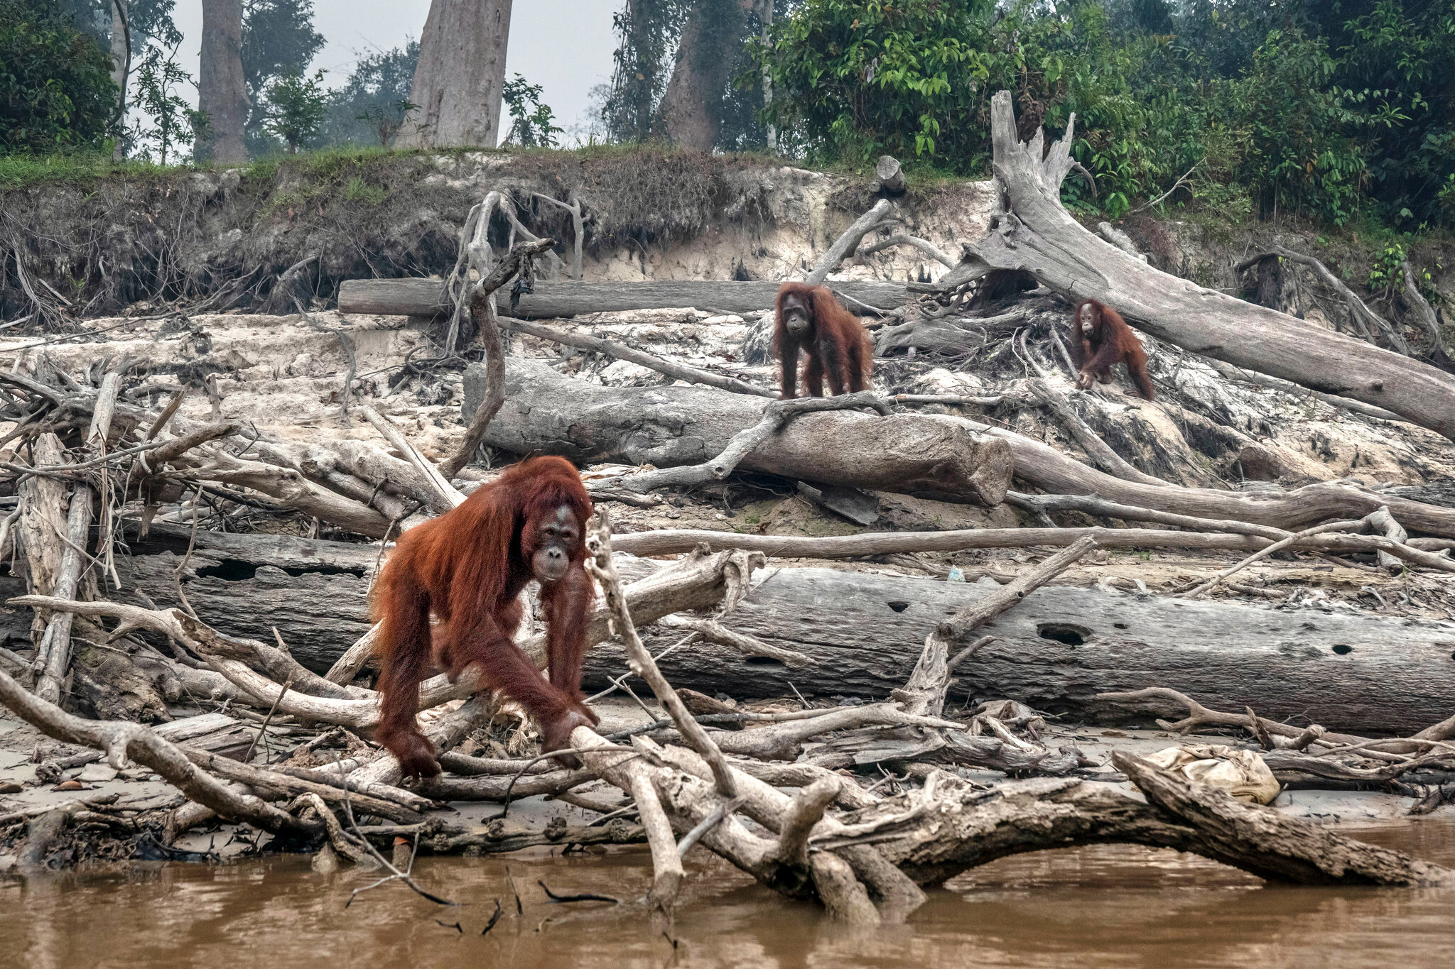
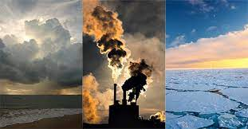
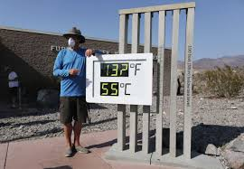
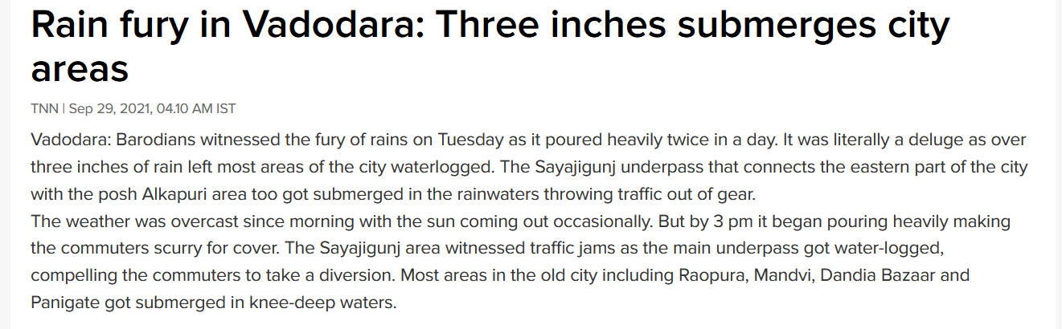
CLIMATE CHANGES
As it name suggests, climate changes refers to change in climate in a sudden manner. While climate defines a specific weather or cycle of weathers which is observed and stated of about 25-30 years, and there changes refers to sudden change is induced by supporting factors. These factors include Global Warming, Manufacturing goods and even also overconsumption of them, Pollution, especially man activities done in water, and so on.
Observed Scenarios are: Hotter Temperatures, More Severe Storms, Increased Drought, Loss of Species (It is because that environment would not that suitable for them)
One of the major effect is Uneven Distribution of Rainfall: Heavy Rainfall occurs in some areas, and these floods swept the whole properties in slums, indirectly such people suffers from poverty. Also while in storms more powerful lightnings can be spectated.
Red Alert Scenarios: Formation of Cyclones and Tornadoes (if the cyclones and storms are found in hotter and evaporating).
Background Pictorial Representation.

Slide 7
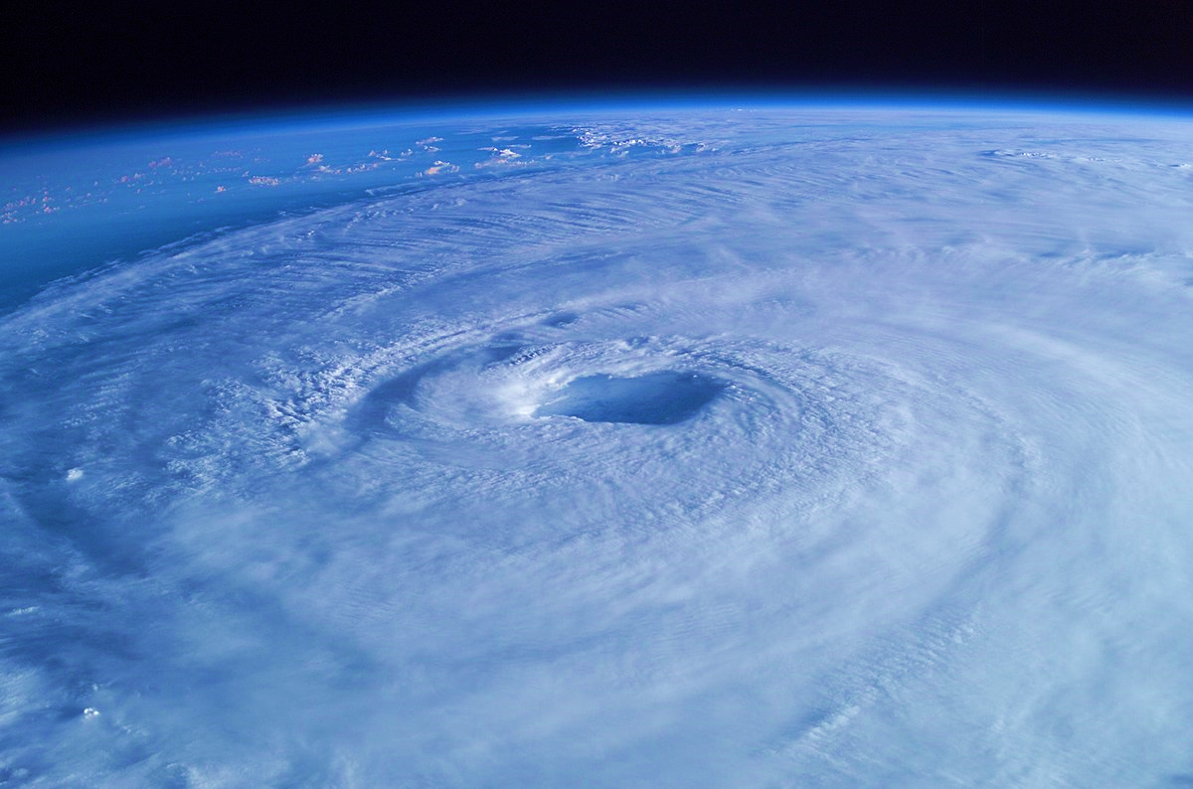
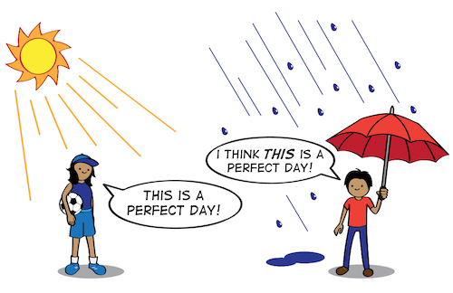
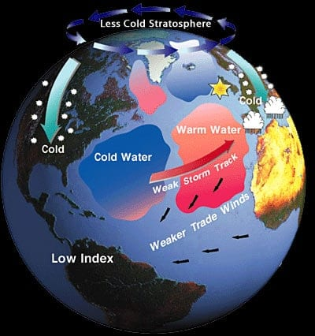
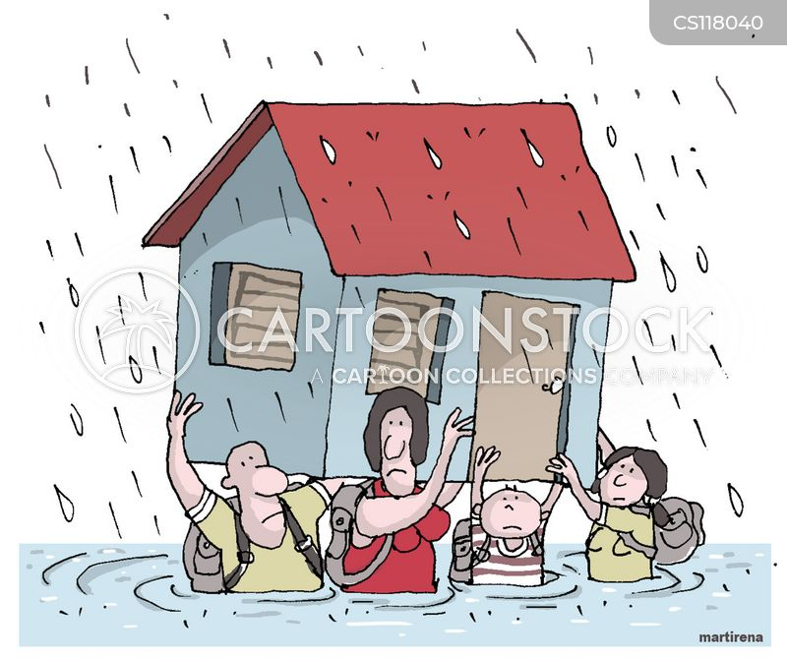
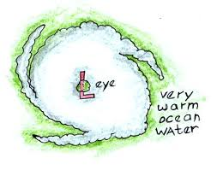
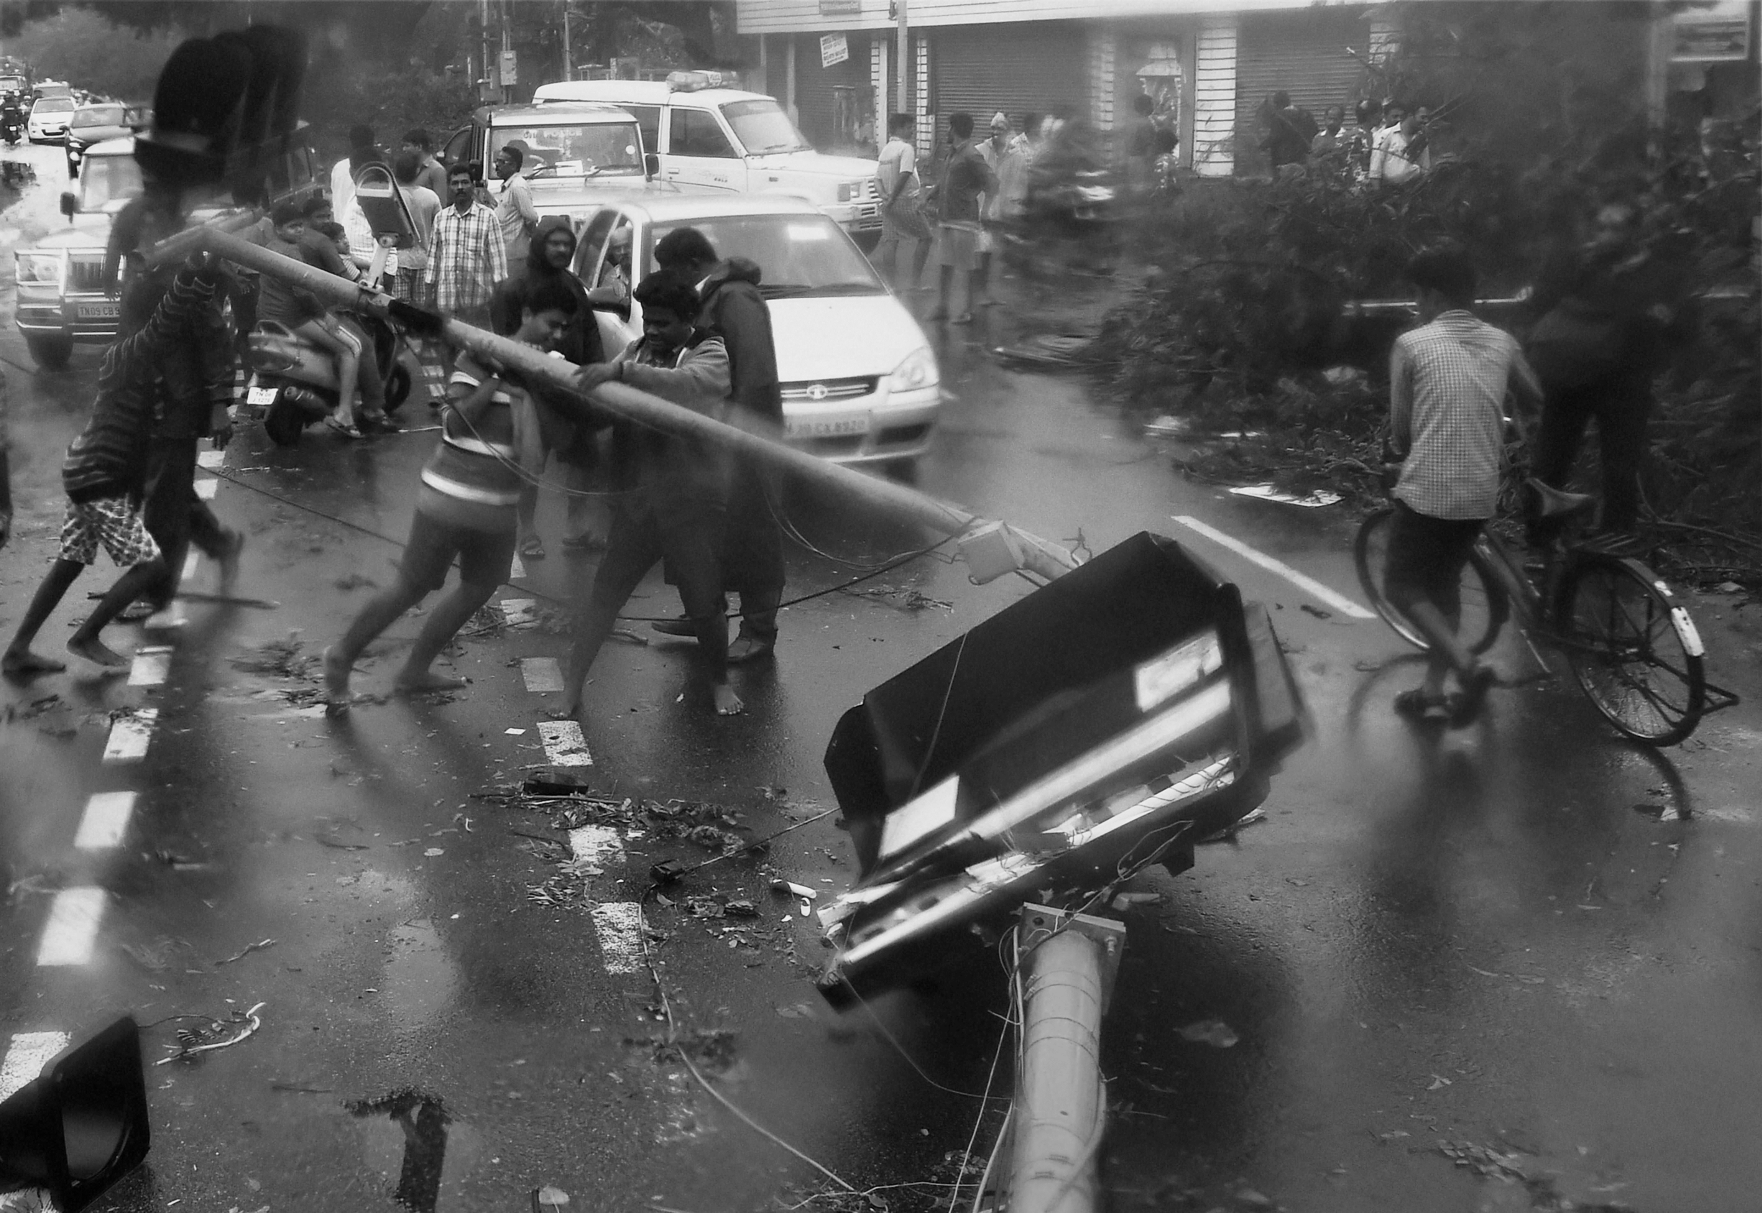
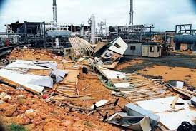
CLIMATIC OSCILATIONS AND CYCLONES
Climate oscillations are the naturally reoccurring changes of earth's climate that are associated with the interactions of atmospheric and oceanic conditions and occur over different geographic scales and time periods.
Some of the common examples are Arctic Oscillation (AAO), Arctic Oscillation (AO), Northern Atlantic Oscillation (NAO).
One of the coupled example is La Nina and El Nino Southern Oscillations.
While Cyclone is a large system of winds that circulates about a centre where low atmospheric pressure exists in a counterclockwise direction in northern hemisphere and clockwise in southern hemisphere.
Formation of Cyclones.
Powerful waves generated during cyclones can seriously damage habitats and landforms, particularly coral reefs and shorelines. Ultimately, it creates an impact on the targeted biosphere disturbs the ecosystem.
Climate Oscillations indicates the degree of severe storms and sometimes it either suppresses or enhances cyclone processes.

Slide 8
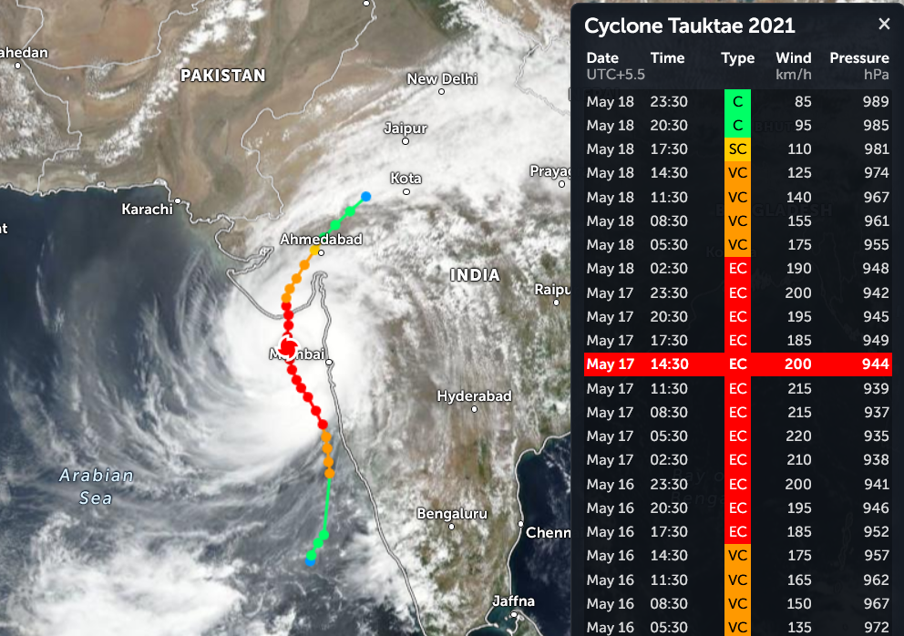
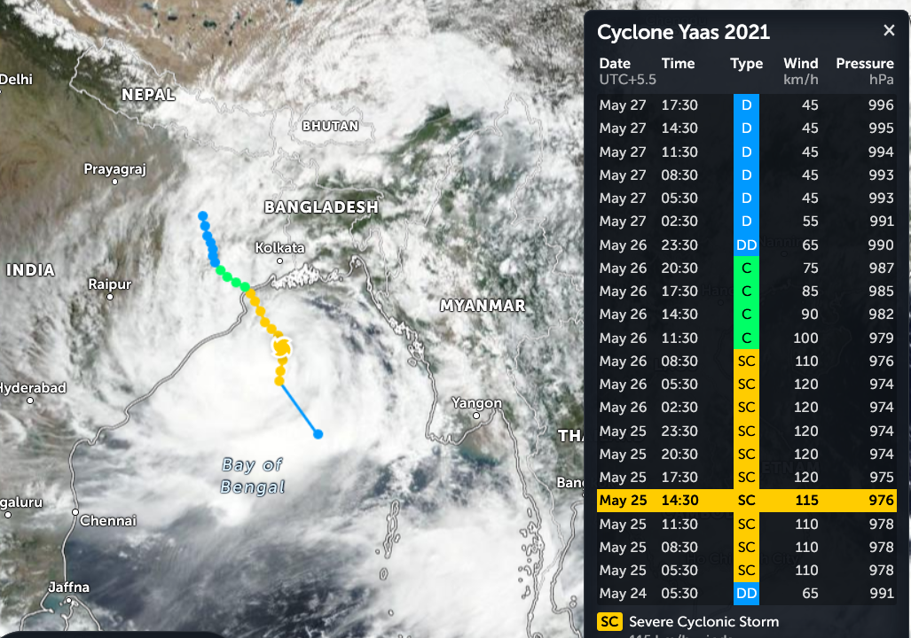
CYCLONE TAUKTAE
This cyclone was active on the date of May 14th to May 19th, 2021. It damaged properties and facilities worth 2.21 BILLION USD. It was a category 4 hurricane . It took broke a record of over 20 years of such cyclone. Over 160 people were dead including 5 from Pakistan. And over 200K people were displaced from their homes. Every second farmer in Gujarat and Maharashtra faced in loss of crops; 70% of unripe mangoes, were wiped away. Una.
CYCLONE YAAS
This 3rd Category Cyclone was active on May 23rd to May 28th, 2021. It swept away made a heavy damage worth of 2.84 BILLION USD and 63 Million USD on Orissa alone. Such heavy damage was done by tornado, which was seen in Hoogly, West Bengal. Since 20 Fatals, Damaged in over 10K villages, and 75 Lakh People were displaced, this cyclone was deadly and ranked. Over 2 Lakh Hectare from Agriculture Land and over 71k Hectare for Horticulture were damaged.

Slide 9
ARABIAN SEA AND BAY OF BENGAL
The Bay of Bengal shaped like a trough that makes it more hospitable for storms to gain force. Moreover, the high sea surface temperature makes matters more worse in the Bay triggering the intensity of the storms.
The Bay of Bengal gets more rainfall with sluggish winds and warm air currents around it that keep temperatures relatively high all year. Lack of landmass between the Pacific Ocean and the Bay of Bengal tend cyclonic winds to move into the coastal areas causing heavy rainfall.
Arabian Sea is heating faster comparing to Bay of Bengal, not even surface, but deeper the ocean to, which we called as ocean currents. As per 2021, from 30 years, Surface temperature is risen from 1.2°C to 1.4°C. All this is about of global warming.

Slide 10
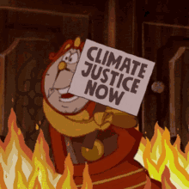

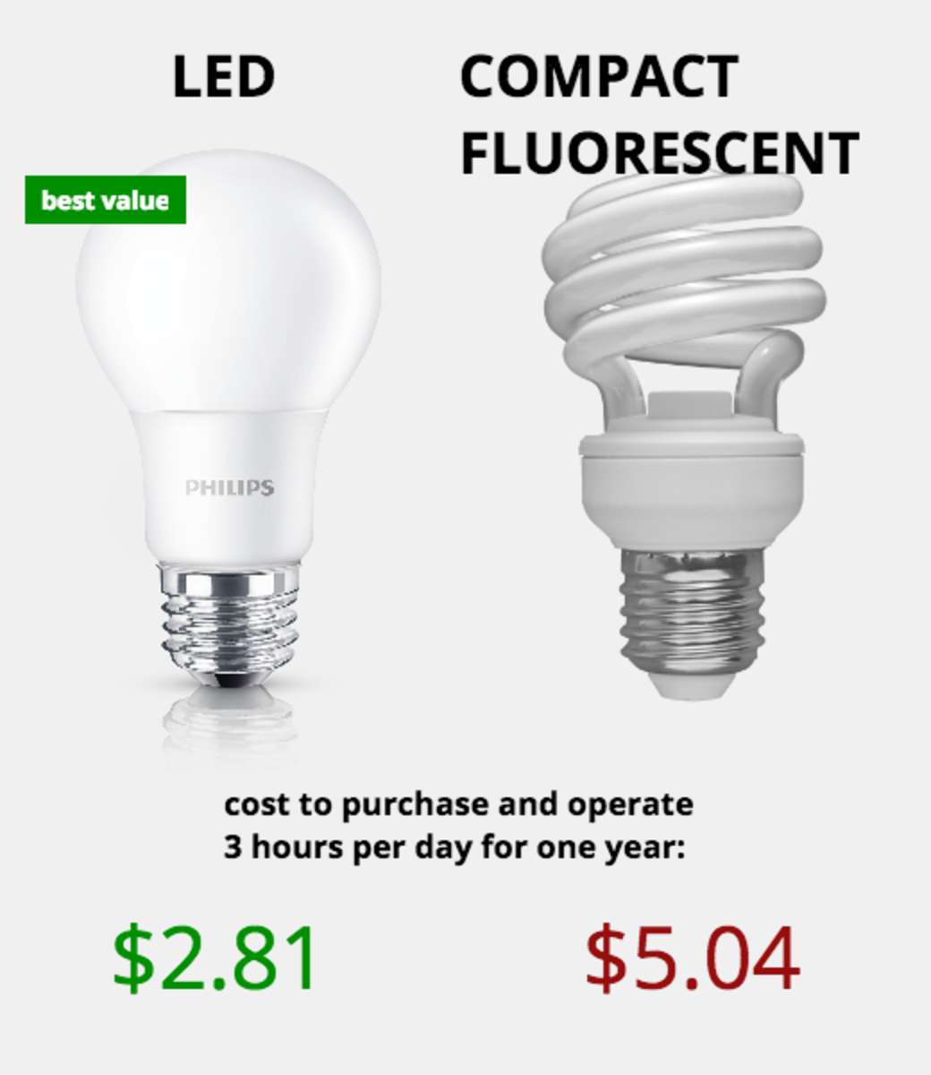
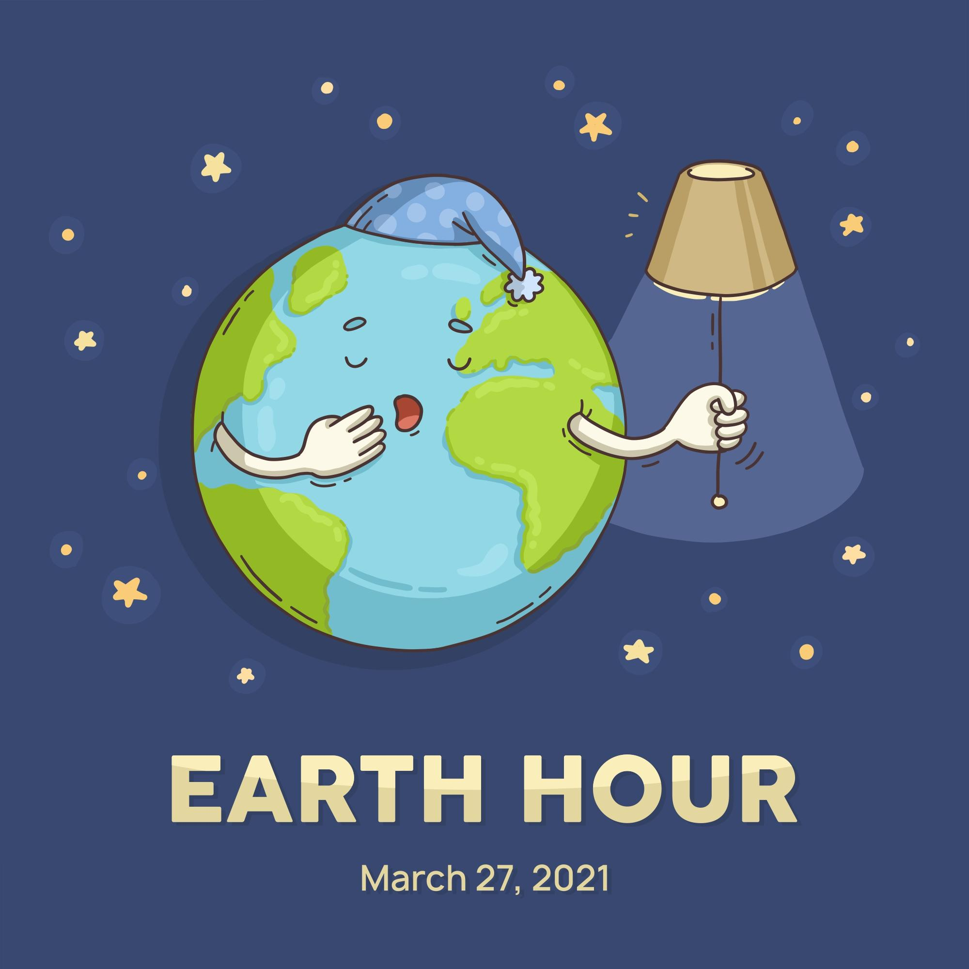
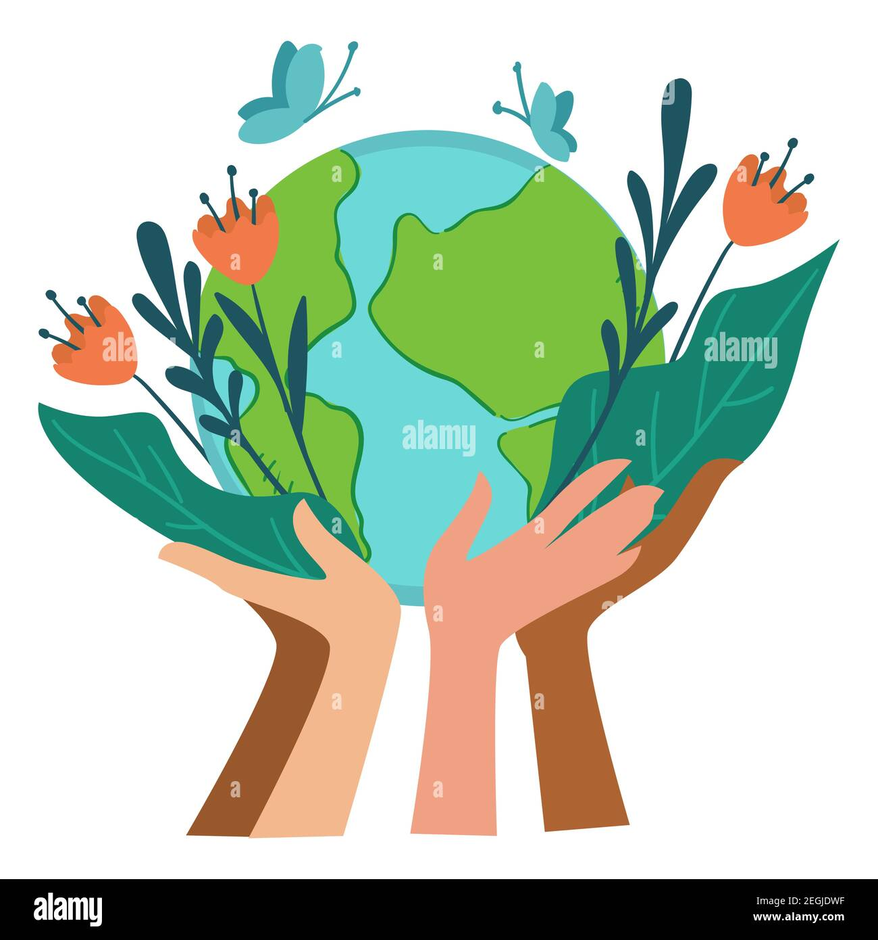
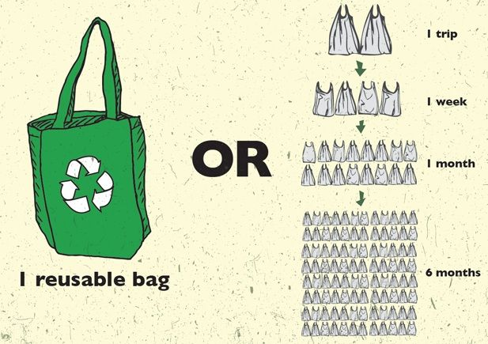
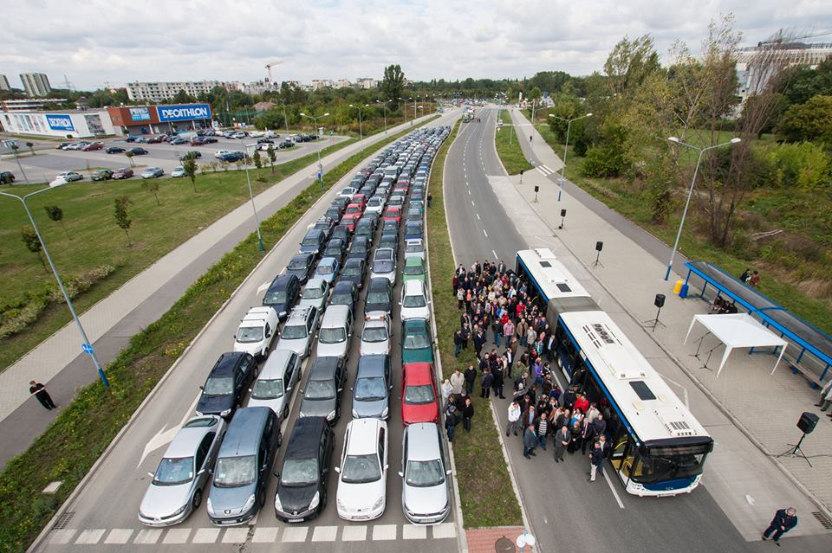
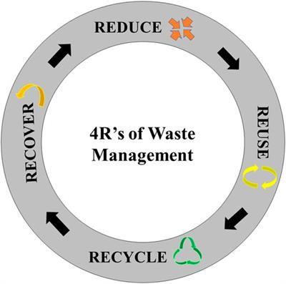

METHODS TO PROTECT THE ENVIRONMENT IN DAILY LIVES
Use public transportation instead of private transport: It significantly reduces air pollution.
Follow the 4’Rs: Reduce, reuse, recycle and recover for the waste management.
Make habits to walk or ride a bicycle instead to drive motorcycles and cars.
Use reusable bags, instead of plastic bags.
Use long-lasting bulbs and lights instead of incandescent bulbs and conventional lights.
Deploy trees, not appliances and vehicles.
Be Socialized and socialize the others.
Earth Hour is a social initiative organized by WWF, where people switch off the lights for 60 minutes.

Slide 11


